Slide 1

Mentorness negra insights
Dashe Jephthah

Slide 2

introduction
This project delves into the analysis of data related to the National Rural Employment Guarantee Act (NREGA), a transformative government scheme aimed at providing rural households with guaranteed wage employment opportunities. The dataset used for this analysis encompasses a wide range of parameters, including the number of job cards issued, the workforce engaged, budget allocation, work completion statistics, and much more. Through the application of data analytics techniques, we aim to gain valuable insights into the implementation and impact of NREGA across different states and districts in India.

Slide 3

Content and aim
The dataset used for this analysis is sourced from official government records and contains information related to NREGA implementation across various states and districts in India. It comprises 28 columns, encompassing data on job cards, worker details, budget allocation, work completion statistics, expenditure, and more. This dataset offers a comprehensive view of the progress and challenges faced by the NREGA program
The aim of this analysis is to see how effective is negra in providing employment to the rural communities in India across 34 states and 736 districts.

Slide 4
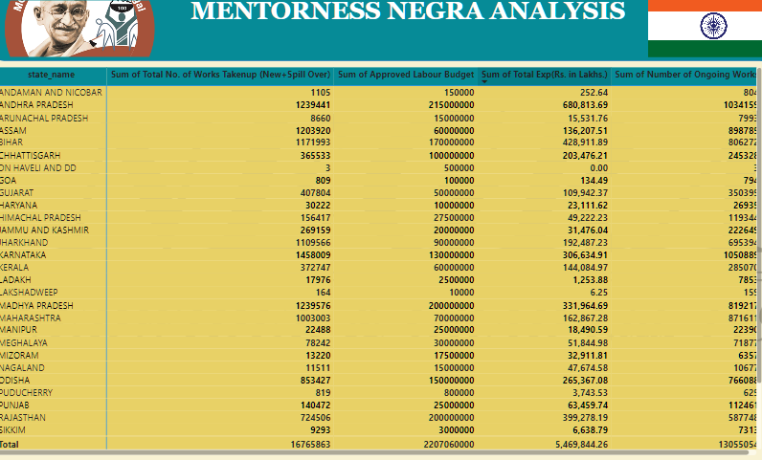
Approved labour budget, total expenditure, ongoing works, work taken up by states

Slide 5
Charts

Slide 6
Summary and conclusion
The completion rate of NEGRA (22%) is considered below average
Based on the results only 0.25% of the budget has been spent pending on the time ratio was recorded
NEGRA has a total of 97million active job cards which indicates a higher participation .
A total of 979millions women's person days indicates a massive participation of women
The total number of differently abled persons worked is 396 thousand
Total average wage rate per day per person is 204.28 thousand
A total of 26 thousand total average days of employment provided per person
The total number of employment is 269mliion with 63M as individuals work
NEGRAS employment rate is at 4.27
The household employed is 46 million household
The average employment of NEGRA is 363.83 thousand
The average employment value is 49.22 lakhs
Total wages is 4.02 million
While total expenditure is 5.47million
NRGRA has a budget expenditure ratio of 0.0025
NEGRA has a work completion rate of 0.22
Total number of works taken up 17million
Total number of ongoing work 13m
Total number of ongoing work(project) 4 million

Slide 7
Thank you
dashejephthah4@gmail.com

